Slide 1
Community consultations
Rebecca evans 8th September 2022

Slide 2
Are you prepared to listen?
What do you call small creatures with bushy tails that live in trees?
Have you already decided how to solve the problem or have you just identified the problem?
Who are you listening to?
Are you prepared to change what you thought to take account of the responses?

Slide 3
Methodology
Community Mapping
Planning for Real
Public meeting or Forum
Workshop or Focus Group

Slide 4
Methodology 2
Questionnaires or surveys
Online
Street stall
Arts and creativity
Engagement.pdf (communityplanningtoolkit.org)

Slide 5
Why engage?
Are you part of the community? Is there a level of trust?
Is the a prize or hook for engagement?
What are the barriers to engagement?
What is the basic level of understanding?

Slide 6
Are you on the same page?

Slide 7
Are you on the same page?

Slide 8
Questions that don’t achieve answers
Do you have any comments?
The Church is the focal point of the community Yes or No
Would it be good to have a local village shop?
What facilities should we provide for young people in the community?
We understand many people are struggling with the cost of living crisis; should we make more allotments available for families?

Slide 9
THINGS TO CONSIDER
Asking others to read the questions first
Different methods of response
What doesn’t the question ask?
Is the question detailed enough or too vague?
Are you offering something you’ll be unable to deliver?
How will you communicate the results and the change?

Slide 10
Communicate
“The single biggest problem in communication is the illusion that it has taken place”
Use the consultation as evidence to funders
How do you weave the answers into a story or case study?
How many times must you communicate?
Communication is essential in building trust

Slide 11



Get creative and have fun!

Slide 12

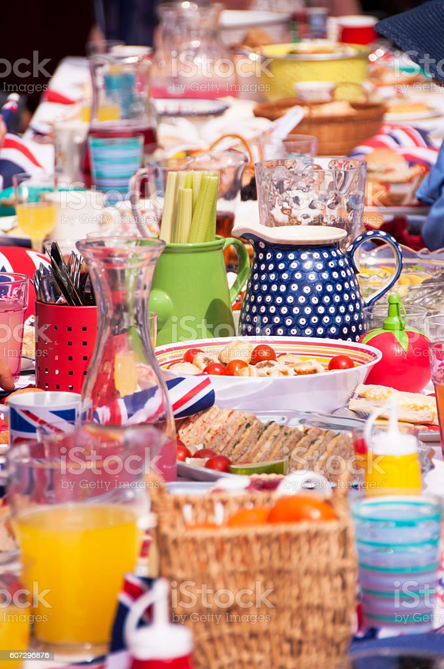

Get creative and have fun!

Slide 13
THANK YOU
Rebecca Evans
Rebecca.Evans@Truro.Anglican.org
01872 360044

