Slide 1
Using Data to Demonstrate Need
Anne Redelinghuys
September 2022
Notes:
In this session we will explore how you can best use data to strengthen a funding application.
SLIDE 2
We will explore:

Slide 2
Session Overview
What is data
Why use data
When to use data
How to use data
Where to find data
Notes:
1.What is data?
2.Why we should use data in funding applications.
3. What data do you need
4.Where to find good data.
5.Practical
6.How to weave it into your application.
We will also explore in the next session:
What a community consultation is.
Top tips for conducting a community consultation.

Slide 3

WHAT IS DATA?
Facts
Numbers
Words
Observation
Description
Quantitive
Qualitive
Notes:
SLIDE 3
What is data
The term data can sound a bit abstract and make one feel uncertain and distant if we do not know what it means.
Data is a collection of facts, such as numbers, words, measurements, observations or just descriptions of things.
Data can be qualitative or quantitative.
Qualitative data is descriptive information (it describes something)
Quantitative data is numerical information (numbers)
Data is a collection of values
Information that is processed in a way to understand
Today’s session is about the data as evidence for project need
How do we use data to evidence the need and where to find that data to proof that your project it needed.

Slide 4

Why use data?
Persuade/Convince
Connect
Strengthen
Add credibility
Confirmation
Reduce Uncertainty
Evidence
Collaboration
Notes:
SLIDE 4
Why use data
Funders connect with the aims/goals of your project.
We develop projects and start up social action because there is a need.
How do we show case there is a need – through the collection of data
For funders it is about investing their money where they have evidence that the need is there and the money will be invested and put to use in a way that they had envisaged.
The data we collect is show casing for the funder what the need is and why the money will be worth going to this specific project or organisation.
Using data in your application, therefore, has a persuasive effect. You’re not just saying that there is a need for your project or work, you are demonstrating that through numbers, statistics, and research.
Data also reduces uncertainty for funders. They process hundreds if not thousands of applications and so you want to make it as easy as possible for them to see your project as a safe pair of hands.
By demonstrating the need you are giving them the confidence that their money will make a difference and the investment is sound.
Using reputable sources of information adds further credibility to your proposal. It demonstrates that you’re not just speaking on your own authority but that what you’re saying is backed up by other organisations, research bodies, are statistics councils. Combining different and multiple sources of data can make this aspect even stronger

Slide 5



DATA DEMONSTRATING NEED
NEED
DATA
Funder Aims/Objectives
Notes:
SLIDE 5
Aim Well
When applying for funding we must demonstrate that there is a need for the project.
Need demonstration is dependent on data gathered.
Having evidence of need that aligns with the funding aims, is what will convince the funders to consider investing.
At the end of the funding period there is also the expectation to finish off with a feedback report that proves the impact made by the project / activity to ensure the funder’s investment was worth it.
Again, to do this feedback we will need data to base our findings on.
This is then compared against the original funding aims that proves the project was a success.
This feeds into the funder that you are a reliable organisation group in delivering projects that are needed in the community.

Slide 6


Questions to ask?
Data can be used to answer important questions such as:
Who is in need?
What do they need?
Where are they?
How much help do they need?
What will the impact be if we don’t do anything?
Notes:
SLIDE 6
Know what you want to find out/ what data you need
What exactly do you want to find out
Who are the vulnerable people in this situation likely to be needing support?
Age
Health
Location
Type of support ie loneliness and food and heat
Where will you find these people
Are they already linked into other services, age UK, Schools, food support groups, homeless

Slide 7
Specific Questions
Who is in need
Age/Gender/Health/Ethnicity/income/Single
What do they need
Where are they
What will the impact be if we do nothing?
Food/shelter/clothing/exercise/company
Wellbeing/Physical and Mental Health
Cities/Towns/Rural
Notes:
SLIDE 7
Questions to be very specific – Ask the right questions
Know what you want to know
Know where to find the answers and how to get the information
Data can be used to answer important questions such as:
Who is in need? What does the data say about your area of need, who are they? For example, is there a particular issue with age-based loneliness?
What do they need? Does the data demonstrate a deficit of a particular type of provision, e.g., food, social, exercise?
Where are they? Can your data demonstrate the need in your community, and therefore the particular need for your project?
How much help do they need? Can the data help inform the extent of work you are going to need to do, and therefore bolster your case for seeking funding?
What will the impact be if we don’t do anything? The data might also help you demonstrate that if nothing is done things will either stay the same or actively continue to get worse.
Consider
Who we are
How we live
What we do
Health
Age
Single
Income
Crime
Ethnicity
Break up to discuss

Slide 8


Where to find data?
Different types of desk-based community audit information portals include:
What is the overall Index of Multiple deprivation ranking for your neighbourhood?
http://dclgapps.communities.gov.uk/imd/iod_index.html
How does poverty in your parish compare locally and nationally?
https://cuf.org.uk/lookup-tool
Checkmystreet.
UK Local Area
FindaHood
Nomis
local area report
Other tools to use:
Notes:
SLIDE 8
Where to find data?
There are a huge number of data sources and at the end of this presentation and in the follow up email we’ll be sharing a list of helpful links to data sources.
Community Audits
Community audits are when you go out to the local community with your own questions/surveys, conversation groups, discussions, stories of people with lived experience to gather data information about what is needed, what are the gaps and the barriers and what assets are available/ strengths
Community audits are basically a data mapping exercise.
They help us to understand the resources there are within a neighbourhood or area, the possible needs of local people, or area of work
and the responses or services we might be able to offer to address gaps or develop community life.
There are three basic ways of undertaking a community audit or profiling exercise.
• Desk-or kitchen table-based research.
• Walking the streets to observe
• Talking and listening to people. This might include using questionnaires, knocking on doors and chatting with people and holding meetings or group conversations/sessions to explore different issues.
Do not under-estimate your own data that you collect
Different types of desk-based community audit information portals include:
Checkmystreet.
UK Local Area
FindaHood
Nomis
local area report
ONS
CUF

Slide 9
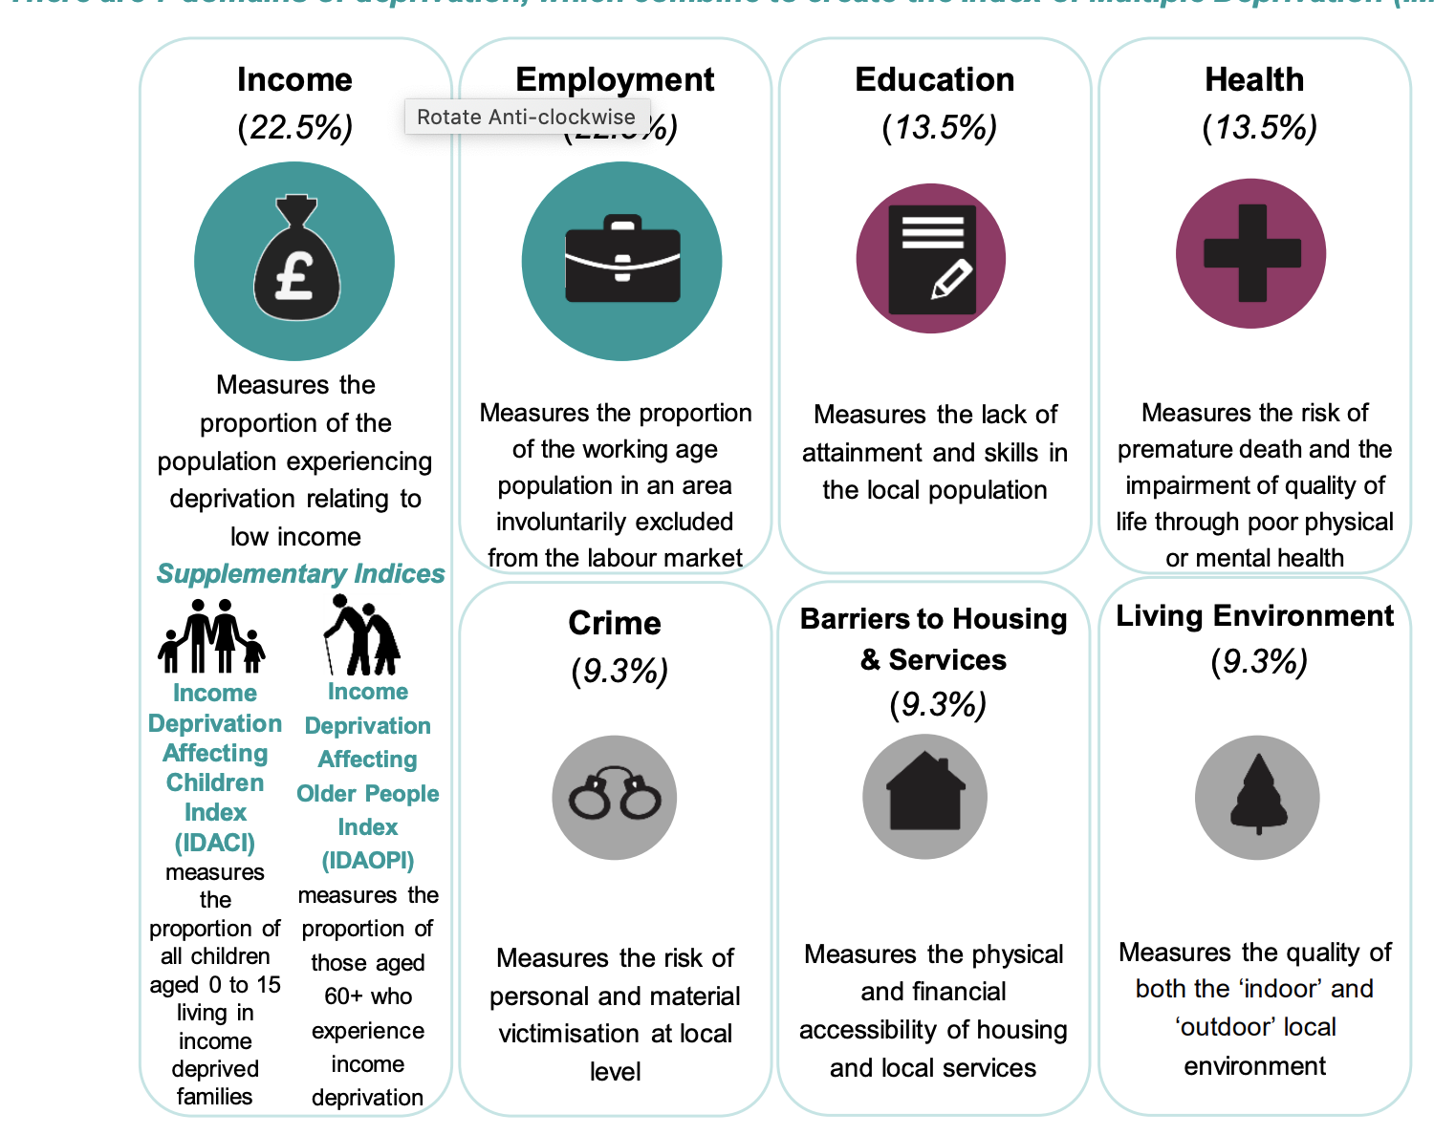
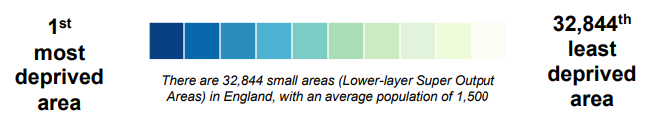
Indices of Multiple Deprivation
The Indices relatively rank each small area in England from most deprived to least deprived. There are 7 domains of deprivation, which combine to create the Index of Multiple Deprivation (IMD2019).
https://imd-by-postcode.opendatacommunities.org/imd/2019
http://dclgapps.communities.gov.uk/imd/iod_index.html
Notes:
SLIDE 12 &13
CUF Portal Practical
Let use the CUF data comparison tool to look at the poverty comparison of your local are versus national levels
We can also try some of the other tools. They are all in the resource doc that will be available on the website and emailed to you.
Let work on a project
Cost of living crisis and it is winter – people will need two things
Hot food
Warm place

Slide 10
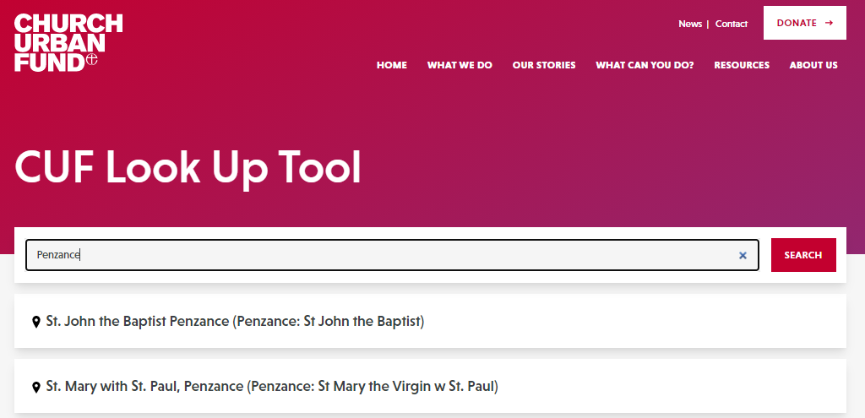
Cuf lOOK UP TOOL
https://cuf.org.uk/lookup-tool

Slide 11
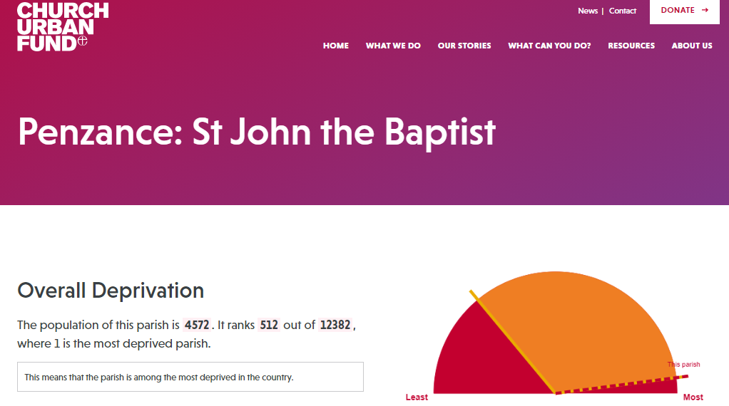
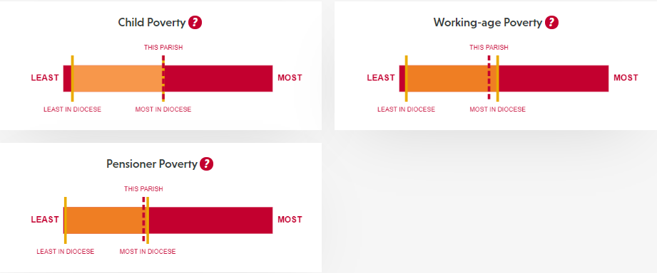
Cuf lOOK UP TOOL

Slide 12
Other sources
For a quick statistical community profile or audit
Streetcheck is one of the best UK-wide local area community audit and profiling sites at the moment. Categories: social class, gender, relationship status, age groupings, health and education, qualifications, ethnicity, religion
UK Local Area - deprivation, crime and neighbourhoods.
FindaHood - Neighbourhood communities: age of residents, family structure, crime results, occupations, religious affiliations and some details about gardens and green spaces.
Nomis is a good source for local statistics in England and Wales

Slide 13

How to use data
Keep it simple
Up to date
Make it resonate
Don’t overwhelm
Incorporate data into your project’s story
Inspire HOPE
Notes:
SLIDE 15
How to use data?
You now have all this information. Use it wisely. Do not through it all in lengthy paragraphs and many words to the funder. Summarise it in 2 – 3 short sentences.
Keep it simple. Data that fails to be informative will make it harder to communicate your message. While data is important, overwhelming your funder with data can have the opposite effect and end up being too clinical and removed from the real people at the heart of your project. A balance is key.
A good way of humanising data is to make it applicable to your service users. Instead of just showing data, incorporate it into your project’s story. Who are the people behind the statistics?
Make sure your data is up to date. If you provide incorrect information, it will lower credibility in your proposal and also lower the credibility of your project/team. For most data sources just doing a little bit of research online can help you find out if it’s the most up to date.
Think carefully about what data will resonate with your funder. Do any of your examples directly relate to their aims? As with our first point, data use should be specific and not just for the sake of using it.
Don’t overwhelm your funder with negative data. There will probably always be a wealth of negative data out there which demonstrates need,
Make sure at the end of your proposal that you leave them hopeful for the future, not completely overwhelmed and pessimistic about the possibility of change.

Slide 14
THANK YOU
Anne Redelinghuys
anne@transformation-cornwall.org.uk
074 9291 5531

Slide 15


Slide 16
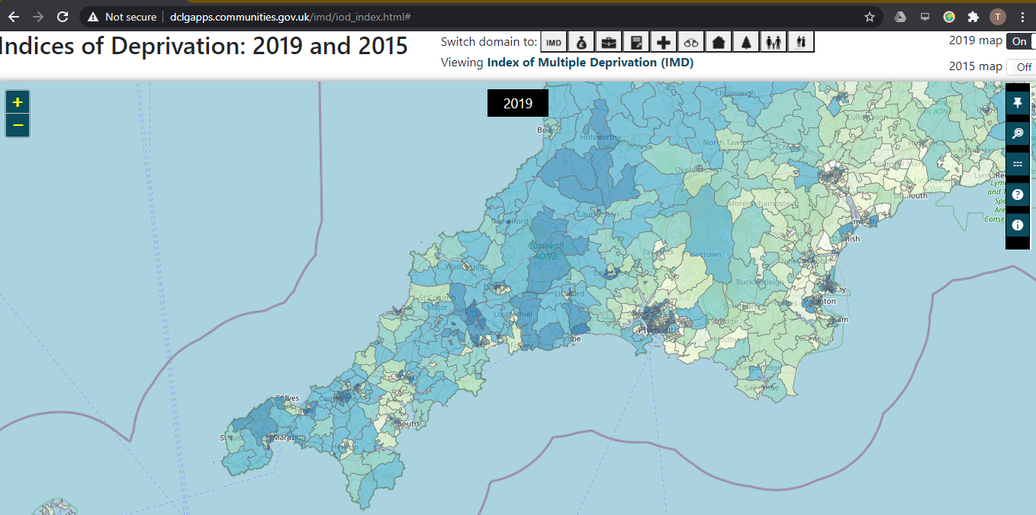
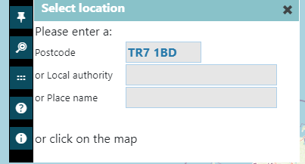
Indices of Multiple Deprivation

Slide 17
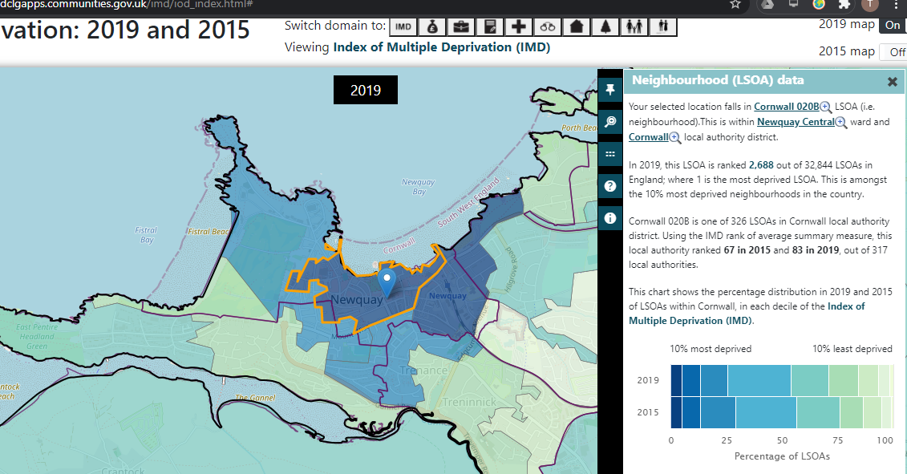
Indices of Multiple Deprivation

